Slide 1

HUNGER HALT
Team Members Details
1.G Yaswanth Sai – 21N31A6718
2.G Akash – 21N31A6721
3.U Chandu – 21N31A6756
III Year B.Tech-II Semester – CSE (Data Science)
Under the Guidance of
Mrs.M.Swathi
Assistant Professor & Dept of ET
MRCET CAMPUS (UGC AUTONOMOUS INSTITUTION)
B.Tech III Year – II Sem | Application Development – II | External Project Review

Slide 2
Abstract
In India, despite significant progress in various fields, a large segment of the population still faces the challenges of hunger, malnutrition, and food wastage. The coexistence of these issues creates a complex problem that requires urgent attention and effective solutions. In India, the challenges of hunger, malnutrition, and food wastage persist, impacting millions of lives. Our proposed solution aims to leverage technology and community participation to create a sustainable and impactful platform that connects donors, NGOs, and volunteers, facilitating the donation and distribution of food and other essential items to those in need. In summary, the complex issues of hunger, malnutrition, and food wastage in India demand urgent attention. "Hunger Halt," with its innovative use of technology and community engagement, stands as a beacon of hope. Connecting donors, NGOs, and volunteers, this platform not only optimizes food distribution but also addresses root causes through education and sustainability efforts. As "Hunger Halt" strives to be a catalyst for positive change, it holds the promise of creating a more resilient and nourished future for millions across the nation.

Slide 3
Introduction
Hunger Halt is a community-driven initiative focused on combating food insecurity and hunger.
The project aims to ensure that individuals and families have access to nutritious food, regardless of their circumstances.
“Our mission is simple yet profound: to empower individuals and organizations to combat hunger and create a world where everyone has access to nutritious food.”
“Utilizing technology and community engagement to streamline food donation and distribution processes.”
“Driven by the belief that every individual deserves access to adequate and nutritious food.”

Slide 4
Proposed System
Purpose: Address food insecurity by revolutionizing the food donation and distribution process.
Creating a user-friendly platform to connect donors with recipients efficiently.
Streamline communication and coordination between stakeholders to maximize impact.
The proposed system for Hunger Halt aims to combat food insecurity by leveraging technology and community engagement.
By creating a streamlined platform for food donation and distribution, Hunger Halt seeks to make a meaningful impact in alleviating hunger and nourishing communities.
Stores donation details, user information, and logistical data for efficient tracking.

Slide 5
Architecture Diagram or System Diagram

Slide 6
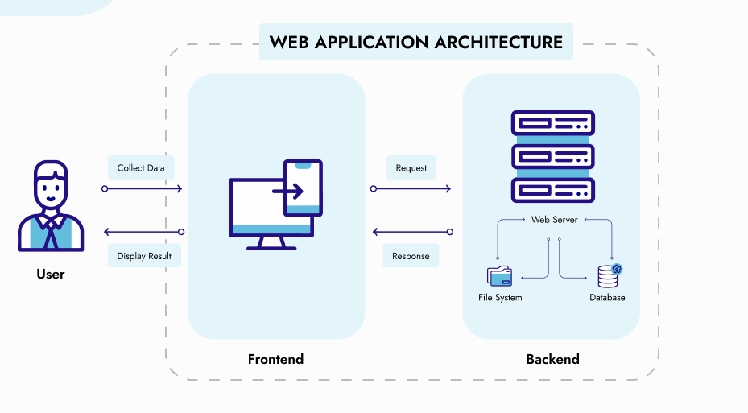
System Architecture

Slide 7
Software Requirements Specification (SRS) & Hardware Requirements Specifications(HRS)

Slide 8
Software Requirement Specifications (SRS)
Development Environment
Frontend Development
Backend Development (React js)
Database
Version Control
Deployment

Slide 9
Hardware Requirement Specifications (HRS)
Development Machine
Testing Environment
Deployment Server

Slide 10
Implementation
Donation Management: Secure system for donors to browse and select items to donate, specify quantity, and choose preferred NGOs for donation. For to store donation data and manage donation requests.
Integration with Firebase, and Google Maps: Integrating Firebase for real-time database management, user authentication, and cloud storage. Linking the Google Maps using JavaScript API for implementing location-based services, such as geocoding and mapping.
Scalability and Sustainability: Designing the platform with scalability and sustainability in mind, ensuring that it can accommodate a growing user base and evolving needs. Implements cost-effective solutions and best practices to ensure the long-term viability of the platform.
Donor & NGO’s Dashboard:
Implementing features for donors to manage their donations, such as editing or cancelling donations.
Implementing features for NGO’s to view donation requests, accept donations.

Slide 11
Application Modules
1)User Registration and Authentication:
It allow users to create accounts and log in securely.
Implementing authentication to ensure that only registered users can access certain features.
2)Donation Tracking and Reporting:
Implementing system to track donations from donors to NGOs.
Providing reporting features for donors and NGOs to view the impact of their contributions.
3)Admin Panel:
Providing an admin panel for platform administrators to manage users, donations, NGOs, and volunteers.
Implementing moderation features to ensure compliance with platform policies.

Slide 12
System Modules (UML Diagrams)

Slide 13
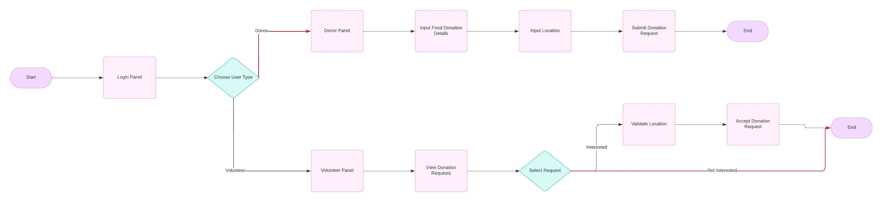
Flow Chart

Slide 14
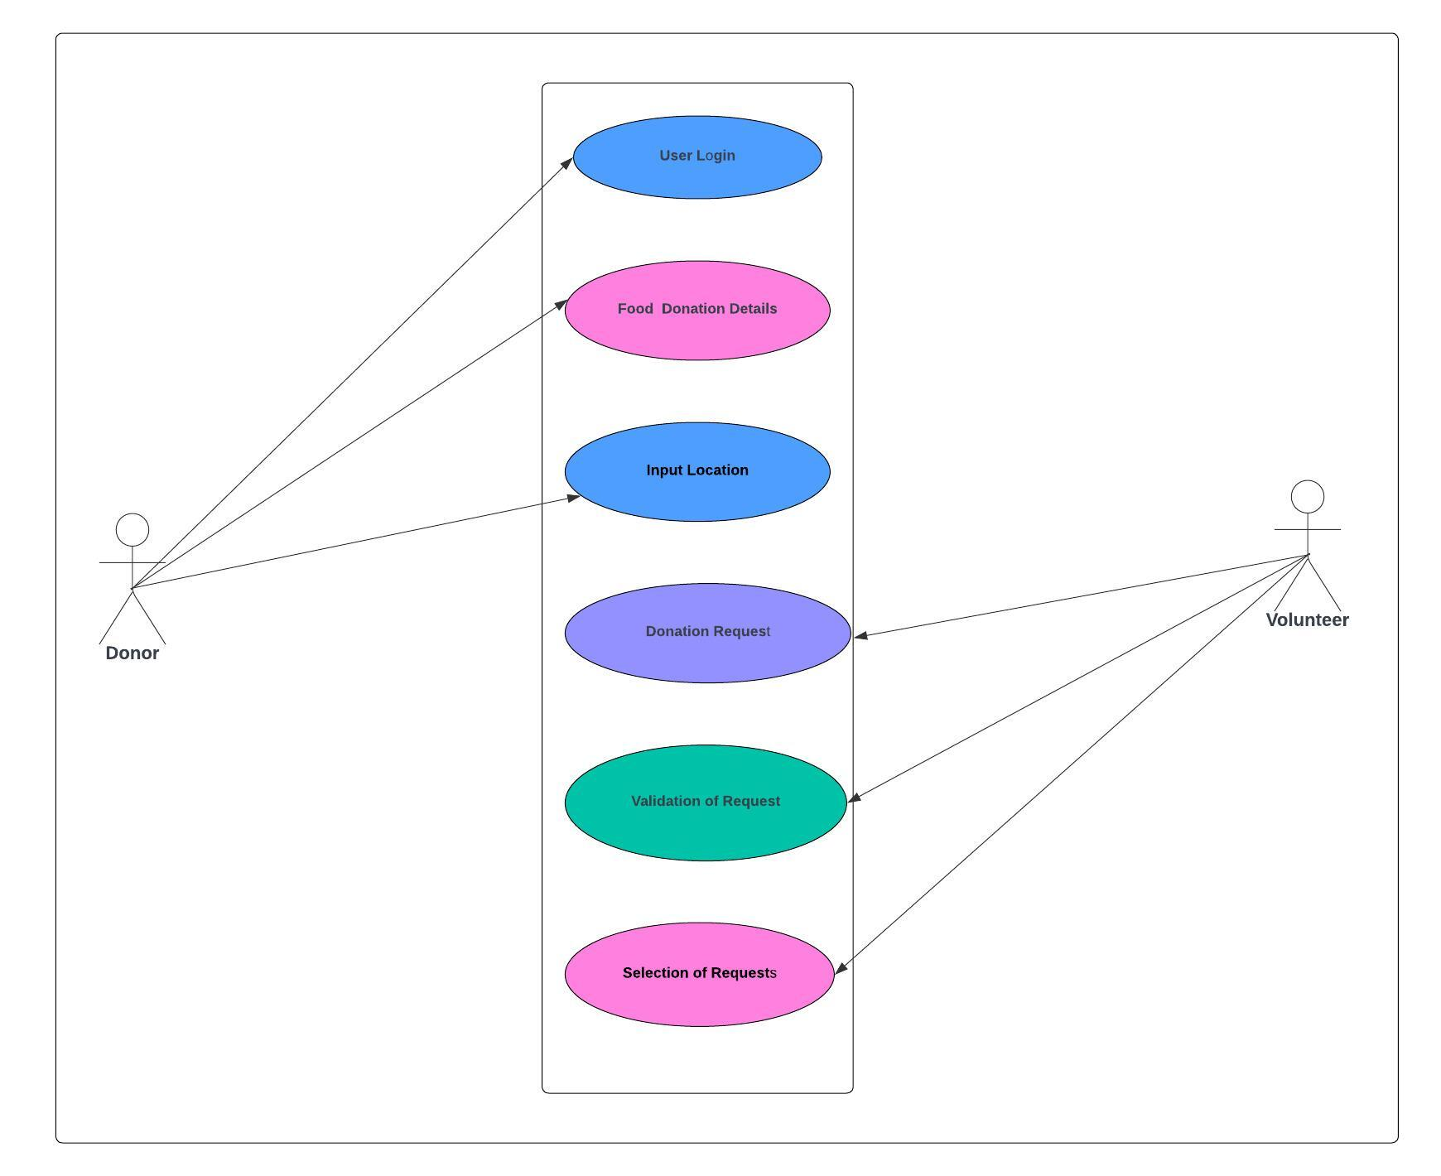
Use Case Diagram

Slide 15
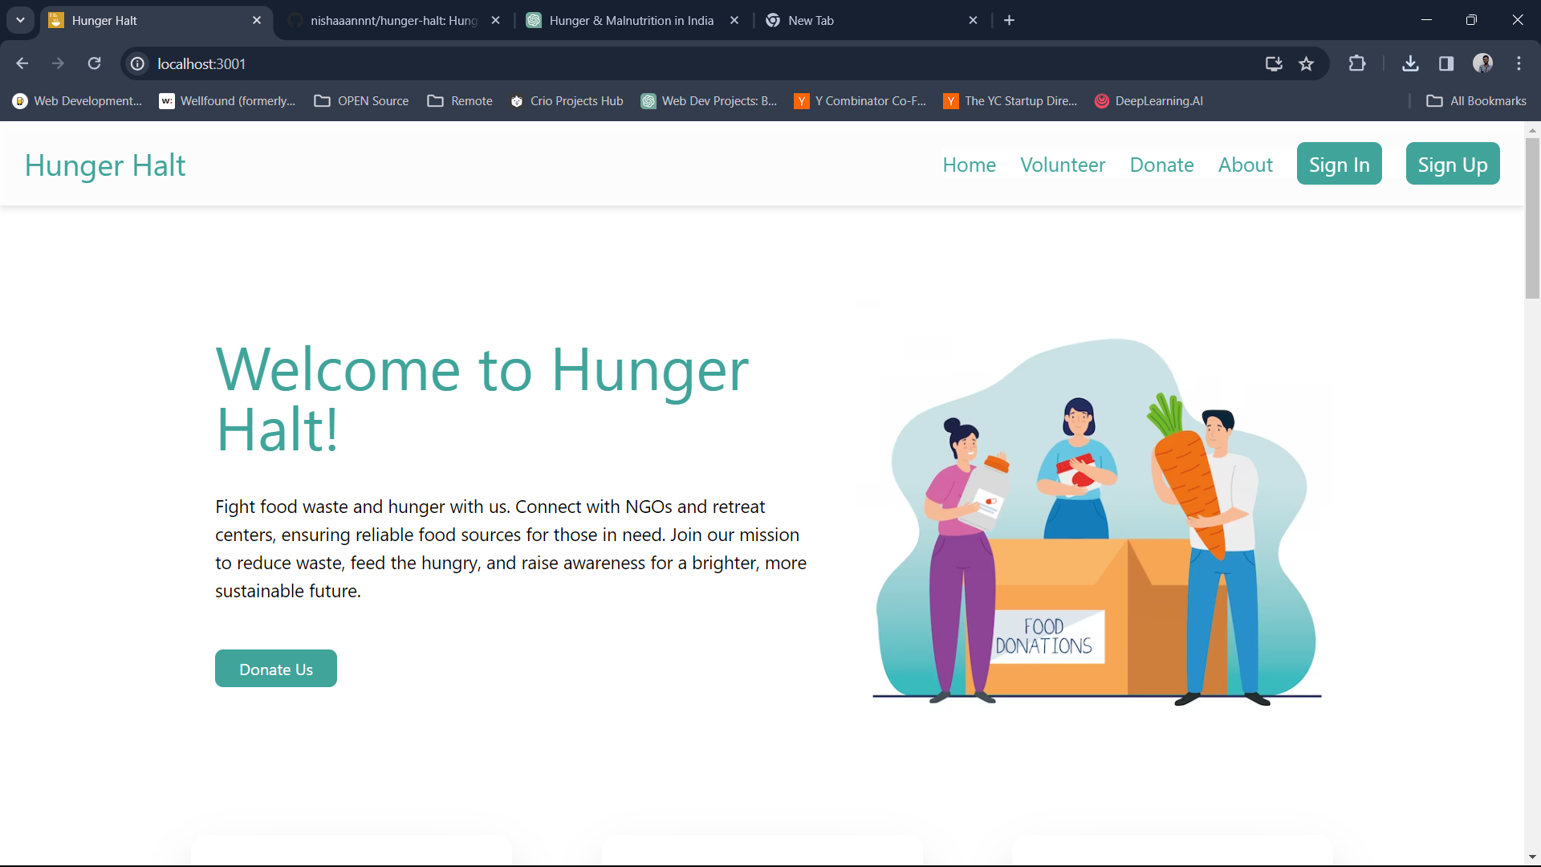
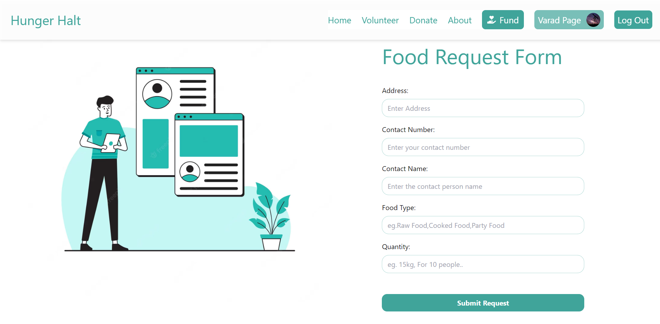
Output Screens

Slide 16
Conclusion & Future Scope

Slide 17
Conclusion
Our project aims to address the pressing issues of hunger, malnutrition, and food wastage in India through a technology-driven platform.
By connecting donors, NGOs, and volunteers, we create a community-driven approach to combating food insecurity.
This platform offers an easy way for people to donate food and essential items, reducing wastage and ensuring that those in need receive support.
Through partnerships, education, and awareness, we seek to create a sustainable and impactful solution to these critical issues.
Together, we can make a difference and build a healthier, more food-secure future for all.
Our journey is not just about building a platform; it's about creating a movement—a movement of kindness, empathy, and action.

Slide 18
Future Scope
Our journey does not end here; it expands into a horizon of possibilities and opportunities to further our impact.
In the future, we envision enhancing our platform with advanced analytics and AI to optimize donation distribution and volunteer matching.
We aim to expand our reach beyond borders, collaborating with global partners to address food insecurity on a larger scale.
With a focus on sustainability, we plan to integrate eco-friendly practices, such as food recycling and composting, into our platform.
As we evolve, we aspire to be a beacon of innovation, inspiring others to join us in creating a world where no one is left behind due to hunger.

Slide 19
Thank You ☺
Team Members Details:
G Yaswanth Sai - 21N31A6718
G Akash - 21N31A6721
U Chandu - 21N31A6756

